Slide 1
Angular
COTL

Slide 2
What is Angular
angular
AngularJS is a structural framework for dynamic web apps. It lets you use HTML as your template language and lets you extend HTML's syntax to express your application's components clearly and succinctly.
AngularJS's data binding and dependency injection eliminate much of the code you would otherwise have to write. And it all happens within the browser, making it an ideal partner with any server technology.
It attempts to minimize the impedance mismatch between document centric HTML and what an application needs by
creating new HTML constructs. AngularJS teaches the browser new syntax through a construct we call directives.
Examples include:
Data binding, as in {{}}.
DOM control structures for repeating, showing and hiding DOM fragments.
Support for forms and form validation.
Attaching new behavior to DOM elements, such as DOM event handling.
Grouping of HTML into reusable components

Slide 3
SPA Vs MPA
angular
SPA advantages over MPA:
Faster naviagtion
Improved user experience
Decoupling of front-end and back-end development
SPA disadvantages to MPA:
The whole application has to be loaded before start.
UI code is not compiled, so it’s harder to debug and it’s exposed to potential malicious user
SEO (search engine optimization) implications; since your pages are built in the browser, the search engine crawler will see a different version of the page than that of your users

Slide 4
Initial Concepts - JavaScript new features (ES6)
angular
const & let
const and let are here to replace var. const defines a variable that cannot be reassigned (however, if it has inner properties, such a JavaScript object, those can be reassigned). let just defines a new variable.
The difference with var, is that let and const do not get hoisted, i.e., they are local to the innermost defining block.
Multiline strings
Use backticks (`) to enable using multiline strings instead of adding \n\r and continue in a new line
var confirmText = ‘You are about to delete the record\n\r’
+ ‘Are you sure?’
Can now be written
var confirmText = `You are about to delete the record\n\r
Are you sure?`
}

Slide 5
Initial Concepts - JavaScript new features (ES6) (Contd.,)
angular
Modules
Even though JavaScript never had built-in modules, the community has converged on a simple style of modules, which is supported by libraries in ES5 and earlier. This style has also been adopted by ES6:
· Each module is a piece of code that is executed once it is loaded.
· In that code, there may be declarations (variable declarations, function declarations, etc.).
· By default, these declarations stay local to the module.
· You can mark some of them as exports, then other modules can import them.
· A module can import things from other modules. It refers to those modules via module specifiers, strings that are either:
· Relative paths (‘../model/user’): these paths are interpreted relatively to the location of the importing module. The file extension .js can usually be omitted.
· Absolute paths (‘/lib/js/helpers’): point directly to the file of the module to be imported.
· Names (‘util’): What modules names refer to has to be configured.
· Modules are singletons. Even if a module is imported multiple times, only a single “instance” of it exists.

Slide 6
Initial Concepts - JavaScript new features (ES6) (Contd.,)
angular
Arrow functions
There are two benefits to arrow functions. First, they are less verbose than traditional function expressions
var squares = arr.map(function (x) { return x * x })
can now be written as
var squares = arr.map(x => x * x);
But most important, they change the object “this”. Traditional functions have a dynamic this; its value is determined by how they are called.
Arrow functions have a lexical this; its value is determined by the surrounding scope. Arrow functions remove the necessity of binding “this” to the local object or to declare helpers such as var that = this.

Slide 7
Structure of Angular Project
angular
index.html
The main HTML file which includes the required libraries and bootstraps our Angular application
script.ts
The main file in which we’ll be placing our Angular code
system.config.js
Configuration for SystemJS which handles module loading (*) and compilation of TypeScript into JavaScript
tsconfig.json
Configuration for the TypeScript transpiler (*) (*)
core-js
The version of javascript that has the broadest support across all browsers is ES5. Then next version of javascript is ES6.
ES6 does not have full support across all browsers yet. (See https://kangax.github.io/compat-table/es6/). This library enables a browser which doesn’t have support for ES6 to run ES6 code, just maybe not in the most efficient way

Slide 8
Structure of Angular Project
angular
SystemJS
Instead of including all the files we need as script tags in our index.html, in Angular we break up all our code into files called modules.
We then leave it to a module loader to load the modules when they are needed, in the order they are needed. It’s a complicated problem, in a browser we can’t make hundreds of requests to load JavaScript modules one at a time when a module loader requests them so a module loader needs to be clever.
systemjs.config.js
SystemJS needs help to figure out when and how to load up certain modules, e.g. if we ask for a module called @angular what does that mean? What should it load up? Which version? This configuration is stored in the systemjs.config.js file.

Slide 9
Angular Fundamentals
angular
TypeScript vs JavaScript
From the previous lecture we named the file we are going to type our code into script.ts The reason the file ends in .ts instead of .js is that Angular is written in a superset of JavaScript called TypeScript.
TypeScript is the ES6 version of JavaScript plus a few other TypeScript only features which Angular needs in order to work.
Transpilation
Browsers don’t support TypeScript. Browsers barely support ES6 JavaScript. So how can we write our code in TypeScript? We use something called a transpiler which converts from one language to another.
We can write in TypeScript and have a transpiler convert to ES6 or ES5.

Slide 10
Data Binding
Angular
Data-binding in AngularJS apps is the automatic synchronization of data between the model and view components. The way that AngularJS implements data-binding lets you treat the model as the single-source-of-truth in your application.
The view is a projection of the model at all times.
When the model changes, the view reflects the change, and vice versa.

Slide 11
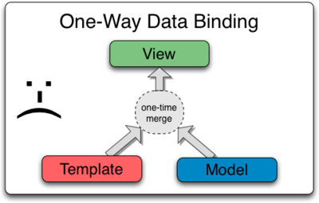
Data Binding in classical Templates
Angular

Slide 12
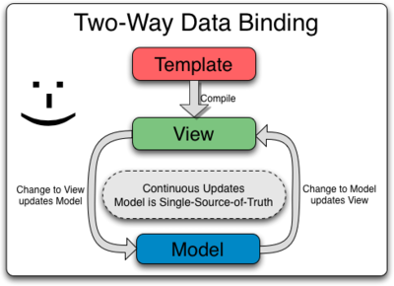
Data Binding in Angular
Angular

Slide 13
Different ways of Data Binding
Angular
There are different ways to data-bind elements in a form. Suppose the component has a property called person, which is a class with the properties “name”, “dateOfBirth” and “gender”. We can data-bind using:
· Interpolation: displays a model property (or function) value, simply by writing the component’s property to display in double curly brackets: {{ person.name }}. This is a one-way data-binding from the model to the view.
· Property binding: binds an element property to a model property (or function). Use square brackets for this: <input type=”text” [value]=”person.name”>. This is a one-way data-binding from the model to the view.
· Event binding: binds a model function or an expression to an event. Use parenthesis for this: <input type=”text” (change)=”person.name = $event.target.value”>. This is a one-way data-binding from the view to the model.
· ngModel: an Angular directive that combines both property and event binding, creating a two-way data-binding. ngModel is actually more of a helper, but the developer can create more specific directives to achieve this, or even just split the binding in property and event as the previous cases. As ngModel it’s a merge of those types of bindings, the syntax uses both square brackets and parenthesis: <input type=”text” [(ngModel)]=”person.name”>.

Slide 14
Conceptual Overview
Angular
Concept | Description
Template | HTML with additional markup
Directives | extend HTML with custom attributes and elements
Model | the data shown to the user in the view and with which the user interacts
Scope | context where the model is stored so that controllers, directives and expressions can access it
Expressions | access variables and functions from the scope
Compiler | parses the template and instantiates directives and expressions
Filter | formats the value of an expression for display to the user
View | what the user sees (the DOM)
Data Binding | sync data between the model and the view
Controller | the business logic behind views
Dependency Injection | Creates and wires objects and functions
Injector | dependency injection container
Module | a container for the different parts of an app including controllers, services, filters, directives which configures the Injector
Service | reusable business logic independent of views

Slide 15
Controllers
Angular
In AngularJS, a Controller is defined by a JavaScript constructor function that is used to augment the AngularJS Scope.
Controllers can be attached to the DOM in different ways. For each of them, AngularJS will instantiate a new Controller object, using the specified Controller's constructor function:
the ngController directive. A new child scope will be created and made available as an injectable parameter to the Controller's constructor function as $scope.
a route controller in a $route definition.
the controller of a regular directive, or a component directive.
If the controller has been attached using the controller as syntax then the controller instance will be assigned to a property on the scope.
Use controllers to:
Set up the initial state of the $scope object.
Add behavior to the $scope object.

Slide 16
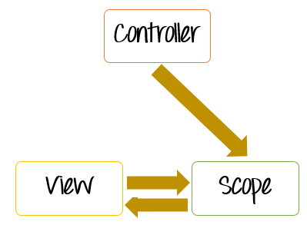
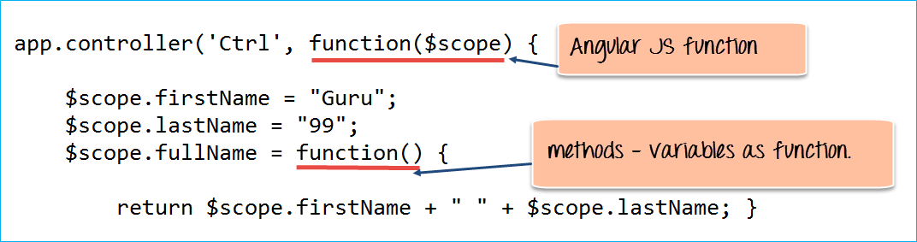
Controllers (Contd.,)
Angular
The controller's primary responsibility is to control the data which gets passed to the view. The scope and the view have two-way communication.
The properties of the view can call "functions" on the scope. Moreover events on the view can call "methods" on the scope. The below code snippet gives a simple example of a function.
The function($scope) which is defined when defining the controller and an internal function which is used to return the concatenation of the $scope.firstName and $scope.lastName.
In AngularJS when you define a function as a variable, it is known as a Method.

Slide 17
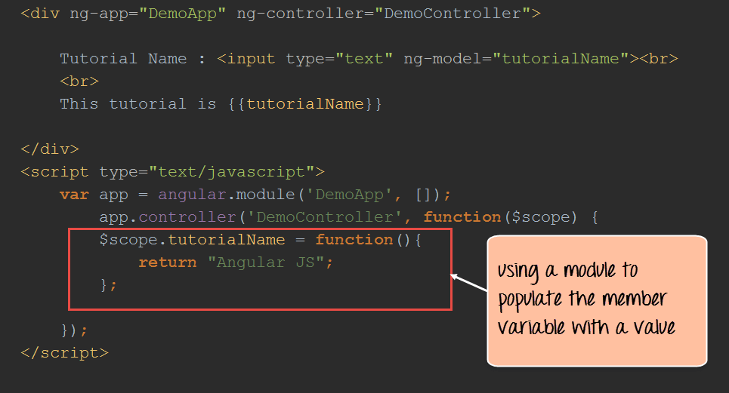
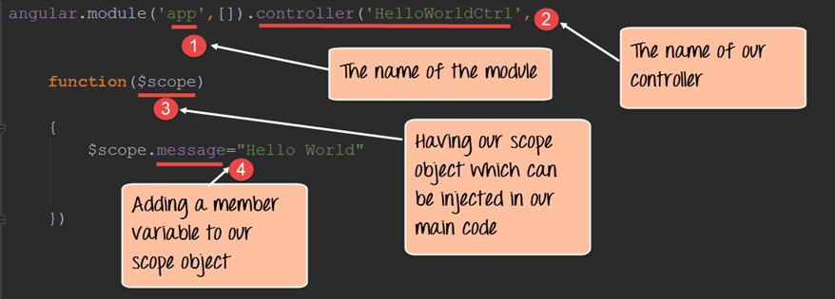
Controllers (Contd.,)
Angular

Slide 18
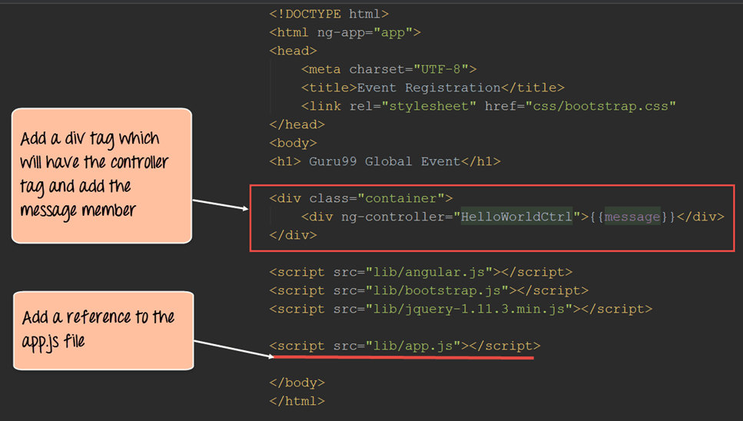
Controllers (Contd.,)
Angular

Slide 19
Templates
Angular
In AngularJS, templates are written with HTML that contains AngularJS-specific elements and attributes.
AngularJS combines the template with information from the model and controller to render the dynamic view that a user sees in the browser.
These are the types of AngularJS elements and attributes you can use:
Directive — An attribute or element that augments an existing DOM element or represents a reusable DOM component.
Markup — The double curly brace notation {{ }} to bind expressions to elements is built-in AngularJS markup.
Filter — Formats data for display.
Form controls — Validates user input.
The following code snippet shows a template with directives and curly-brace expression bindings:
<html ng-app>
<!-- Body tag augmented with ngController directive -->
<body ng-controller="MyController"> <input ng-model="foo" value="bar">
<!-- Button tag with ngClick directive, and string expression 'buttonText' wrapped in "{{ }}" markup -->
<button ng-click="changeFoo()">{{buttonText}}</button>
<script src="angular.js"></script>
</body>
</html>

Slide 20
Understanding Basic Directives
Angular
At a high level, directives are markers (such as attributes, tags, and class names) that tell AngularJS to attach a given behaviour to a DOM element (or transform it, replace it, etc.).
Directives are instructions given to Angular elements to alter their behavior. The most common directive is the @Component declaration, which can be thought of as a directive with a template, meaning it has a clear definition of the elements it will create and manipulate.
The ng-app directive is responsible for bootstrapping your app defining its scope. In AngularJS, you can have multiple apps within the same page, so this directive defines where each distinct app starts and ends.
The ng-controller directive defines which controller will be in charge of your view. In this case, we denote the driversController, which will provide our list of drivers (driversList).
The ng-repeat directive is one of the most commonly used and serves to define your template scope when looping through collections. In the example above, it replicates a line in the table for each driver in driversList.
ng-model is a directive in Angular.JS that represents models and its primary purpose is to bind the "view" to the "model".

Slide 21
Components
Angular
A component is a class that controls a specific part of the screen, called the view. It could be something large and always visible, like a navigation bar, or something tiny and feature specific like a single custom made control.
Most of the application visual logic will be here. That means components provide the views or templates for your application, as well as, the logic behind managing the data bound to those views.
selector: 'app-root'
This is a tag that our application will use to select this component. Meaning that if we want to place this component somewhere with our application, all we have to do is add <app-root></app-root> inside the view of another component.
 | @Component({ selector: 'app-root', templateUrl: './app.component.html', styleUrls: ['./app.component.css'] })

Slide 22
Components (Contd.,)
Angular
templateUrl: './app.component.html'
This is telling your application what template or view to render in association with this Angular component.
The CLI generates an html file for you when you create a new component but if you want you can write your html in this section using back-ticks. I don’t recommend it but it doesn’t hurt to know.
styleUrls: ['./app.component.css']
This defines a component specific style sheet. The CLI also generates this file for every component you create. If you want to add a style definition that is specific to a given component, add it to that component’s style sheet.
You may notice that it is an array. This means that you can declare multiple files here. That can be useful if you want to reuse styles between just a couple of components.

Slide 23
Components – Life Cycle Hooks
Angular
Angular components have a lifespan, and all through it different things happen. Some occur frequently, others only once.
A developer can use this hooks to achieve things like initializing or cleaning up code, or refreshing state.
ngOnChanges()
Used in pretty much any component that has an input.
Called whenever an input value changes
Is called the first time before ngOnInit
ngOnInit()
Used to initialize data in a component.
Called after input values are set when a component is initialized.
Added to every component by default by the Angular CLI.
Called only once

Slide 24
Components – Life Cycle Hooks (Contd.,)
Angular
ngDoCheck()
Called during all change detection runs
A run through the view by Angular to update/detect changes
ngAfterContentInit()
Called only once after first ngDoCheck()
Called after the first run through of initializing content
ngAfterContentChecked()
Called after every ngDoCheck()
Waits till after ngAfterContentInit() on first run through
ngAfterViewInit()
Called after Angular initializes component and child component content.
Called only once after view is initialized
ngAfterViewChecked()
Called after all the content is initialized and checked. (Component and child components).
First call is after ngAfterViewInit()
Called after every ngAfterContentChecked() call is completed
ngOnDestroy()
Used to clean up any necessary code when a component is removed from the DOM.
Fairly often used to unsubscribe from things like services.
Called only once just before component is removed from the DOM.

Slide 25
Pipes
Angular
A pipe is a function that takes a specific input and returns a transformation of it. This transformation may be as simple as applying a format (like in creating a string from a date) or as complex as filtering the input. They may also receive parameters so to know how to format or filter that input.
The way to use them is by adding a pipe character (“|”) next to the value to transform, and then writing the pipe’s name and parameters if needed. A simple built in pipe is “date”, and is used like this:
<p>{{ person.name | uppercase }} was born on {{ person.dateOfBirth | date: ‘shortDate’}} <p>
Here, uppercase transform the person’s name to all upper cases, and datetransforms the date of birth to a string giving it the format specified by the associated parameter.
Pipes can be chained {{ person.dateOfBirth | date: ‘shortDate’ | uppercase }} and custom pipes can be created as easily as a simple function.

Slide 26
Component Interaction with Inputs & Outputs
Angular
Binding and referencing elements inside a component is quite easy. Directives and templating helps do so with very little effort.
the components need to communicate with each other and react according to the stimulus. This can be achieved by using input and output elements, declared by adding the @Input() or @Output() decorators before a component’s property (for inputs) or event emitters (for outputs), or alternatively at the @Component() decorator.
Once a property has been decorated with @Input, or an event emitter with @Output, it can be referenced and bind by the component’s parent component.

Slide 27
Angular Modules
Angular
Angular applications are composed of modules. Modules contain Angular’s objects (components, directives and pipes) and also our own app’s objects. The binding points between modules are the imports and exports.
Technically, a module is a class with a decorator (@NgModule) that has the information of:
· which components, directives and pipes belong to the module (declarations)
· which of those components, directives and pipes are allowed to be used by other modules (exports)
· which other existing modules will be used to accomplish tasks (imports)
· provide services that are going to be used by inner objects

Slide 28
Angular Modules
Angular
Root
Every Angular app has a root module class. By convention it’s a class called AppModule in a file named app.module.ts.
This module will be bootstrapped at the applications entry point and launch the whole angular application.
Core
A core module usually only holds providers for singleton services that need to be imported only once, when the application starts. It should be imported by the root module and never again.
Shared
A shared module simply holds the common components, directives, and pipes and share them with the modules that need them.
Typical objects in them may be formatting pipes, common directives, or even just other module’s elements, because it’s easier to import those in a single module and then re-export only the components that we actually use, while the rest of the modules import only the shared module.
This module should not have providers.
Feature
A feature module delivers a cohesive set of functionality focused on an application business domain, a user workflow, a very specific reusable action (http, routing), or a collection of related utilities.
Basically, it’s just a module like any other, but focused on a specific feature of the application. They exist solely to keep high cohesive functionality together and encapsulate it for the rest of the app to use as a black box.

Slide 29
Angular Router
Angular
The Angular 6 router is an essential element of the Angular framework.
It allows developers to build Single Page Applications or SPAs with multiple components and allow client side navigation and routing between the various components.
One can use the browser's URL to navigate between Angular components in the same way you can use the usual server side navigation.
To tell the paths and destinations to your browser, you need to import the RouterModule and Routes from @angular/router into your app.module.tsfile.
When a user navigates to a page, Angular Router performs the following steps in order:
it reads the browser URL the user wants to navigate to
it applies a URL redirect (if one is defined)
it figures out which router state corresponds to the URL
it runs the guards that are defined in the router state
it resolves the required data for the router state
it activates the Angular components to display the page
it manages navigation and repeats the steps above when a new page is requested.

Slide 30
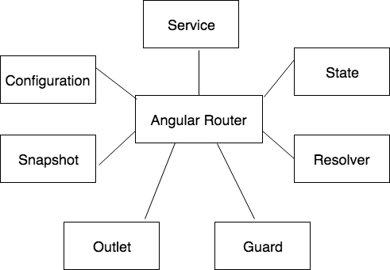
Angular Router
Angular
To accomplish its tasks, Angular Router introduces the following terms and concepts:
router service: the global Angular Router service in our application
router configuration: definition of all possible router states our application can be in
router state: the state of the router at some point in time, expressed as a tree of activated route snapshots
activated route snapshot: provides access to the URL, parameters, and data for a router state node
guard: script that runs when a route is loaded, activated or deactivated
resolver: script that fetches data before the requested page is activated
router outlet: location in the DOM where Angular Router can place activated components.

Slide 31
Angular Dependency Injection
Angular
Angular has a whole framework for applying dependency injection (and can even be used by any JavaScript application, not Angular applications only).
Most dependencies are services, and Angular uses dependency injection via the injector and providers to pass new components the services they need.
The DI framework in Angular consists of 4 concepts working together:
Token This uniquely identifies something that we want injected. A dependancy of our code.
Dependancy The actual code we want injected.
Provider This is a map between a token and a list of dependancies.
Injector This is a function which when passed a token returns a dependancy (or a list of dependencies)

Slide 32
Angular – Observables & Promises
Angular
The way to communicate between components is to use an Observable and a Subject (which is a type of observable)
In a nutshell there are two methods that we're interested in: Observable.subscribe() and Subject.next().
Angular uses observables, implemented with the RxJS library, for all asynchronous events.
RxJS is all about unifying the ideas of Promises, callbacks and data flow, and making them easier to work with.
An Observable is an array or a sequence of events over time. It has at least two participants. The creator (the data source) and the subscriber (subscription – where data is being consumed).
For example, let data = http.get(‘/api.json’). In Angular, data is going to be an Observable of responses, because the HTTP.get method returns a Promise.
The new Angular HttpClient works with Observables by default. Methods such as get(), post(), put() and delete() return an instance of the Observable interface. HTTP requests are only sent when we subscribe to the Observable.
The subject next method is used to send messages to an observable which are then sent to all angular components that are subscribers (a.k.a. observers) of that observable.

Slide 33
References
Angular
https://angular.io/guide/glossary
https://medium.com/front-end-hacking/i-made-an-overview-presentation-of-angular-2-for-my-company-here-is-what-i-came-out-with-e180ea290a0f
https://thinkster.io/angularjs-es6-tutorial

